Slide 1
Music Genre Classification with Parallelized Deep Learning
Group 4: Ashish Roy (NUID: 001044804)

Slide 2
Problem Statement
Not easy to classify music
Can fit classification criteria for various genre
Music files are huge

Slide 3
GOAL
The goal is to develop a parallelized model that accurately classifies the given music genre.
Along with categorizing, the goal is to answer one crucial question, how much parallelism is too much parallelism

Slide 4
Methodology
Map Audio files to their Genre
Convert Audio to Mel Spectrogram Log of size 128*128
Develop a Deep Learning Model to classify the audio accurately

Slide 5
Code files
Data_path.py: Contains all the paths to the files necessary for the execution of the project
Raw_data.py: Converts audio to Mel Spectrogram Log of size 128*128
Data_set_split.py: Splits the dataset into the following shape
Model.py: Deep learning model
Main.py: Main execution file

Slide 6

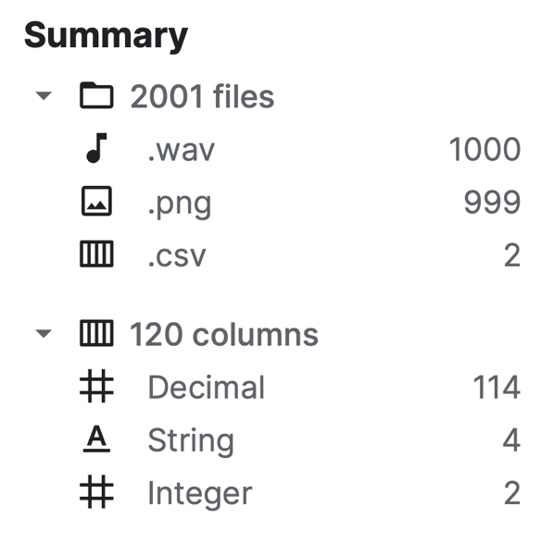
Dataset
Total size: 1.41 GB
Audio Files: 1.33 GB
Total Audio Files: 1000
Total Genres: 10
Blues
Classical
Country
Disco
HipHop
Jazz
Metal
Pop
Reggae
Rock
Notes:
10

Slide 7

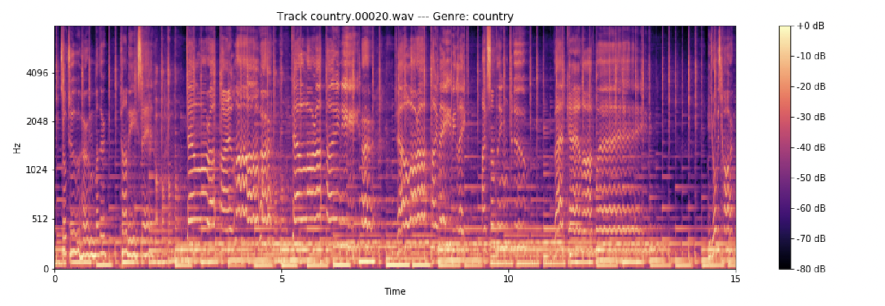
Sample Data

Slide 8
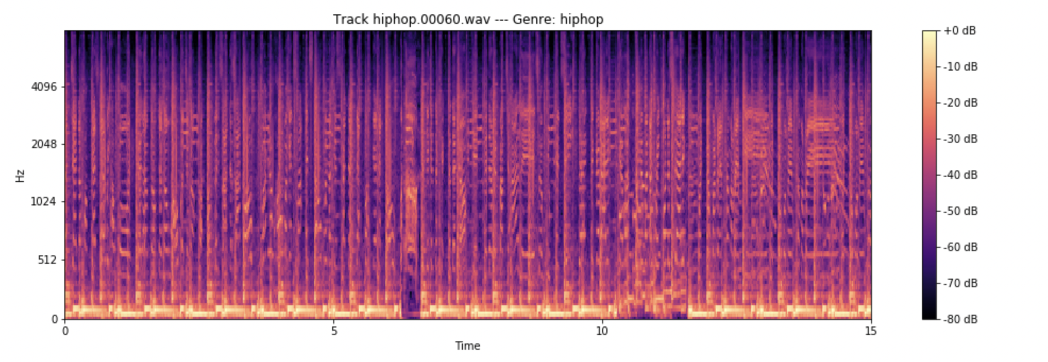
Sample data

Slide 9
Hardware Usage
Cluster: Discovery High-Performance Computing Cluster
Reservation: csye7105-gpu
Reservation Memory: 2GB
Time reserved: 4 hrs
GPU: Nvidia V100-SXM2
GPU Count: 1, 2 and 4
GPU Memory: 32GB/GPU
CPU: 1
Nodes: 1

Slide 10
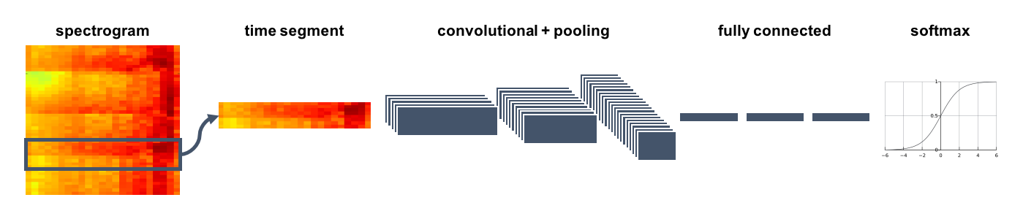
Model Architecture

Slide 11
Train Test Split
x_train shape: (7000, 1, 128, 128)
y_train shape: (7000,)
x_valid shape: (2000, 1, 128, 128)
y_valid shape: (2000,)
x_test shape: (990, 1, 128, 128)
y_test shape: (990,)

Slide 12
Constant Parameters
Train Test Validation size: This is kept constant to the shape mentioned previously.
Number of Epochs: The number of epochs is set to 100 because of limited available time. The model performs at an accuracy of 96% when trained for 2100 epochs on one GPU but takes much time to execute. Similarly, it performs at 75% accuracy for 550 epochs but takes 47 min to complete.
Model Parameters: All the model parameters are the same for all experiments. Changing this would affect the comparison of the parallel performance.

Slide 13
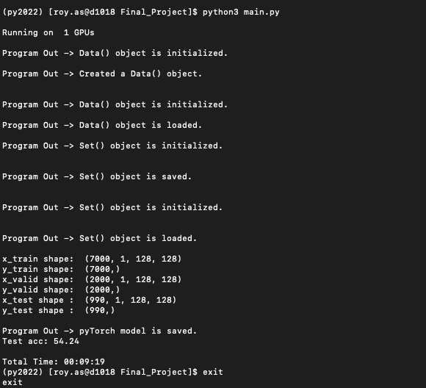
Experiment 1
GPU: v100-sxm2
No. of GPUs: 1
Reservation: csye7105-gpu
Epoch: 100
Batch Size: 256

Slide 14
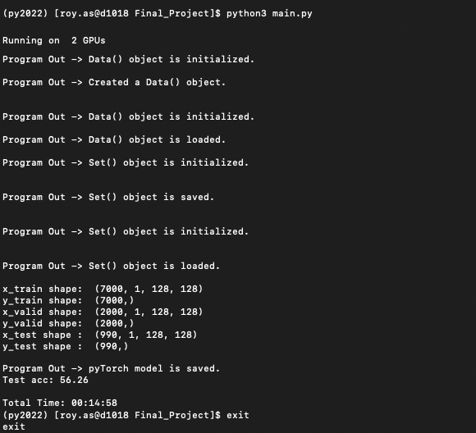
Experiment 2
GPU: v100-sxm2
No. of GPUs: 2
Reservation: csye7105-gpu
Epoch: 100
Batch Size: 256

Slide 15

Experiment 3
GPU: v100-sxm2
No. of GPUs: 4
Reservation: csye7105-gpu
Epoch: 100
Batch Size: 256

Slide 16
Analysis
Experiment Number | Execution Time | Model Accuracy | No. of GPUs
1 | 00:09:19 | 54.25% | 1
2 | 00:14:48 | 56.26% | 2
3 | Infinity | N/A | 4
It is evident that increasing the GPU number increases the model accuracy
But increasing the number of GPUs exponentially increases the execution time
It fails to execute on 4 GPU

Slide 17
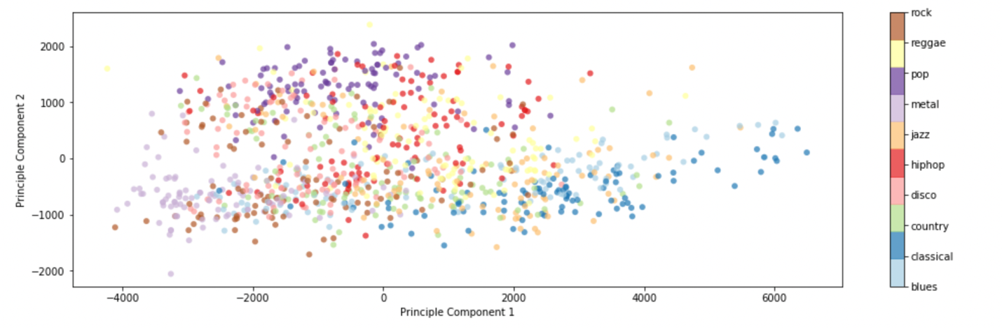
PCA

Slide 18
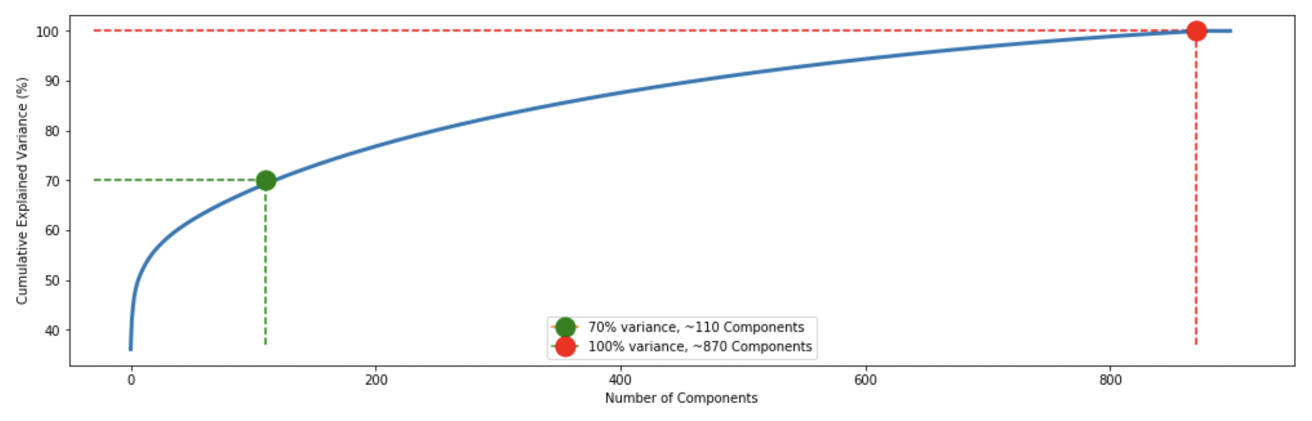
PCA – Component analysis

Slide 19
Conclusion
To classify the music genre perfectly, it is essential only to take components contributing to the model performance. If the aim is to classify music with an accuracy of 90%, only 410 components are required to do so and can perform best at 1 GPU as well.

